Slide 1
CCNA 200-301, Volume I
Chapter 21
OSPF Network Types and Neighbors

Slide 2
Objectives
OSFP Network Types
OSPF Neighbor Relationships

Slide 3
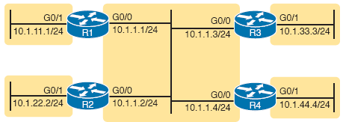
The OSPF Broadcast Network Type

Slide 4
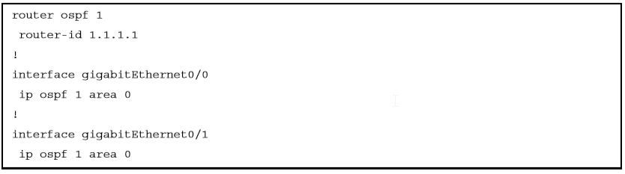
R1 OSPF Configuration

Slide 5
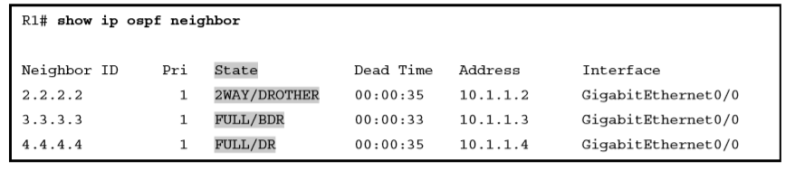
R1’s List of Neighbors

Slide 6
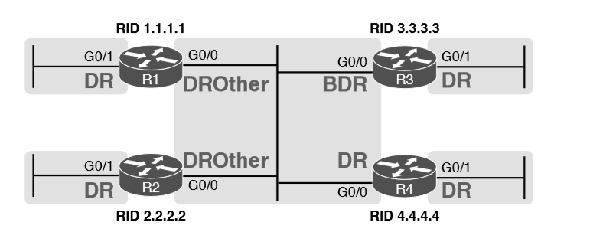
OSPF DR/BDR/DROther Roles in the Network

Slide 7
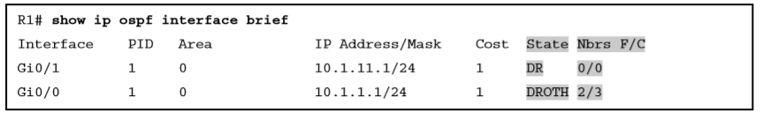
Router R1 OSPF Interfaces: Local Role and Neighbor Counts

Slide 8
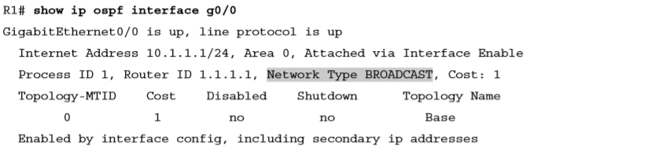
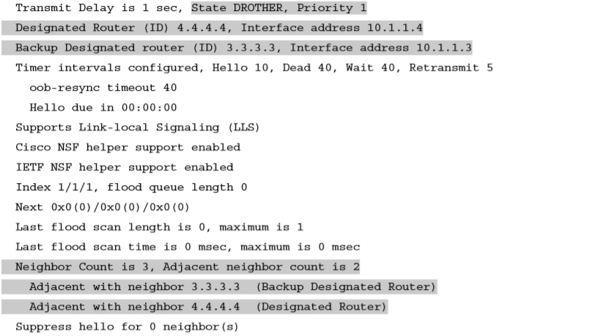
Displaying OSPF Network Type Broadcast

Slide 9
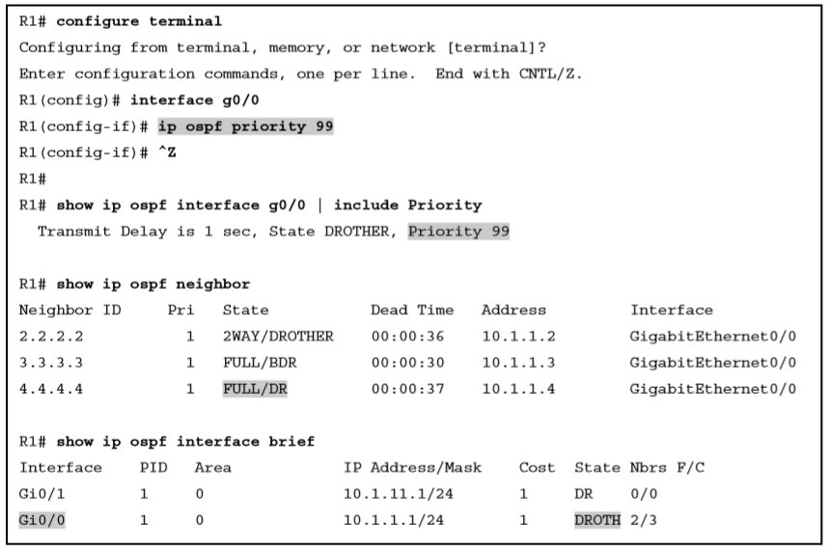
Influencing DR/BDR Election Using OSPF Priority

Slide 10
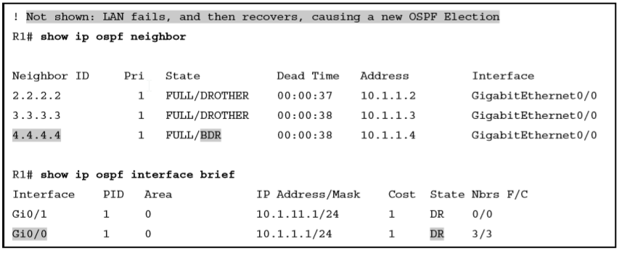
Results of a Completely New DR/BDR Election

Slide 11
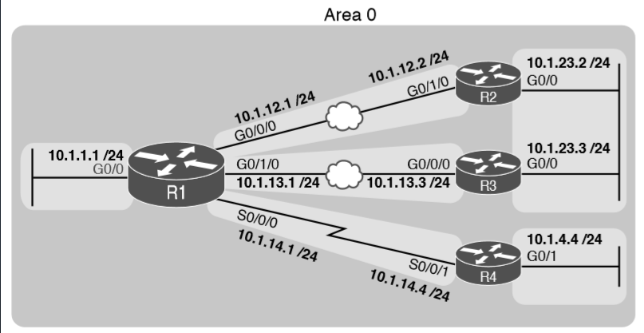
Sample OSPF Design with Serial and Ethernet WAN

Slide 12
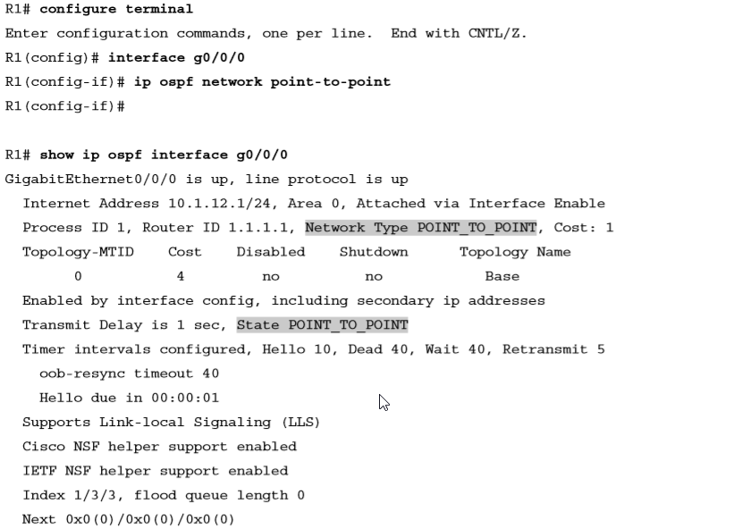
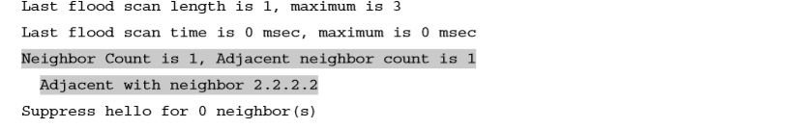
OSPF Network Type Point-to-Point on an Ethernet WAN Interface on R1

Slide 13
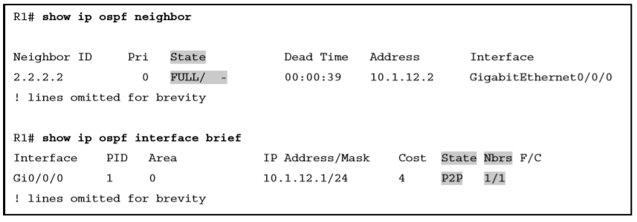
OSPF Network Type Point-to-Point on an Ethernet WAN Interface on R1

Slide 14
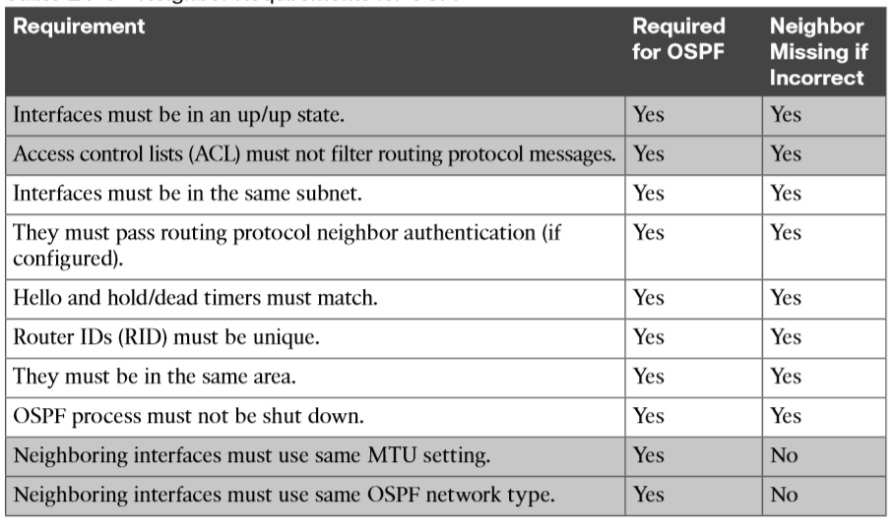
Neighbor Requirements for OSPF

Slide 15
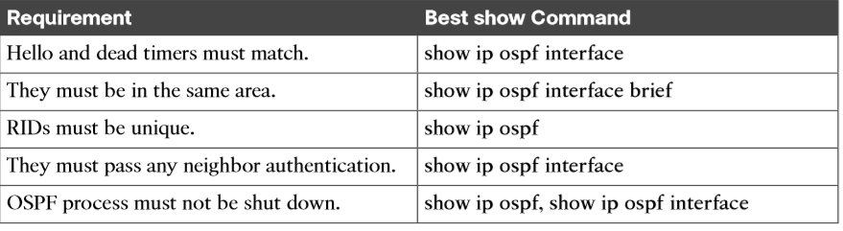
OSPF Neighbor Requirements and the Best show/debug Commands

Slide 16
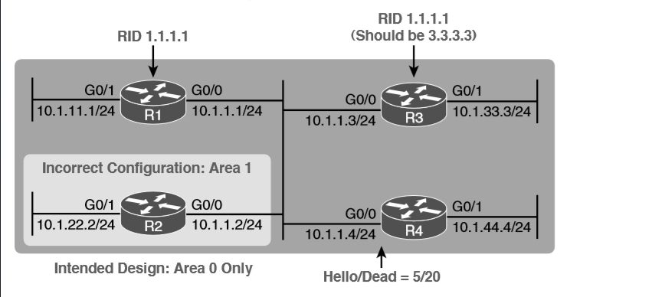
Problems That Prevent OSPF Neighbors on the Central LAN

Slide 17
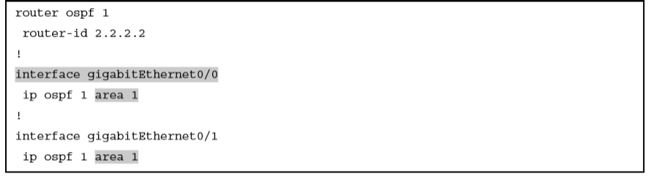
Setting Area 1 on R2’s Interfaces, When They Should Be in Area 0

Slide 18
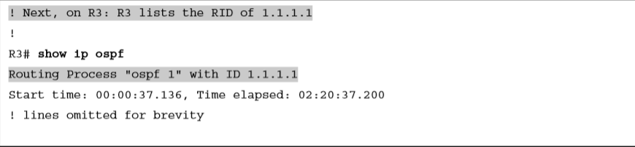

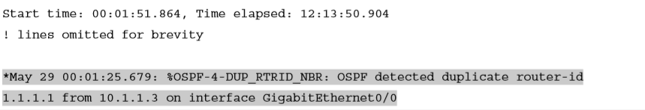
Comparing OSPF Router IDs on R1 and R3

Slide 19
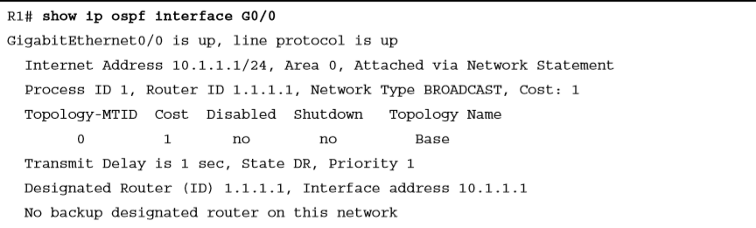
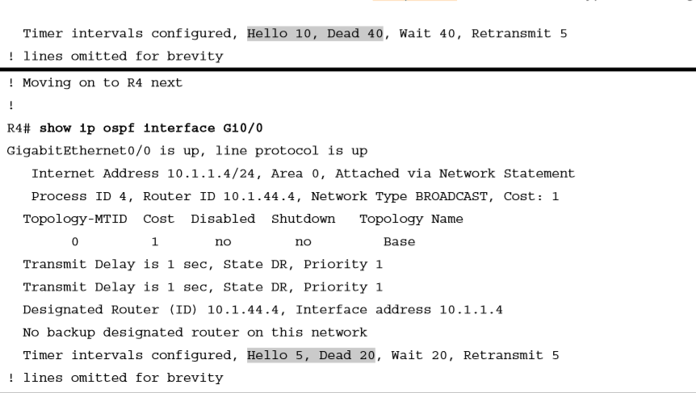
Finding Mismatched Hello/Dead Timers

Slide 20
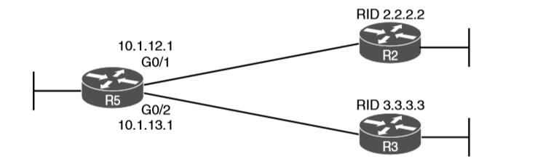
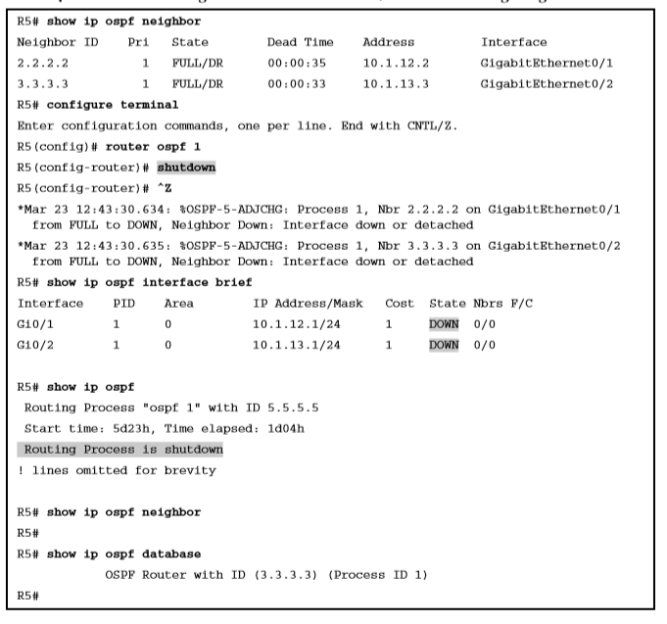
OSPF Process Shutdown

Slide 21
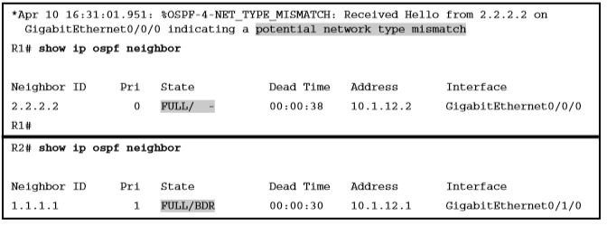
Shutting Down an OSPF Process, and the Resulting Neighbor States

